Slide 1

Apposyansow an Gesva

Slide 2
restrans
Mis Hedra/mis Du: skrifa apposyans 1a, 2a, 3a ha 4a gradh
Mis Kevardhu/mis Genver: kynsa checkyans
Mis Hwevrer/mis Meurth: nessa checkyans

Slide 3
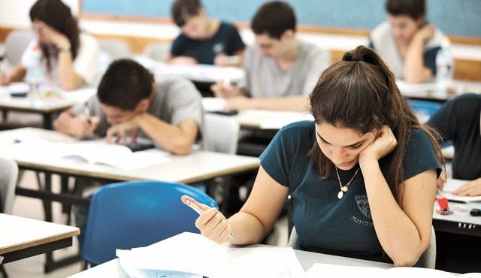


ombrofyer
Mis Me Mis Metheven

Slide 4


merkya
Mis Metheven/Mis Gortheren: kynsa merkyans
Mis Gortheren/mis Est: eyljeckyans
Mis Est: dadhel yn kever an merkow

Slide 5

sewyansow

Slide 6
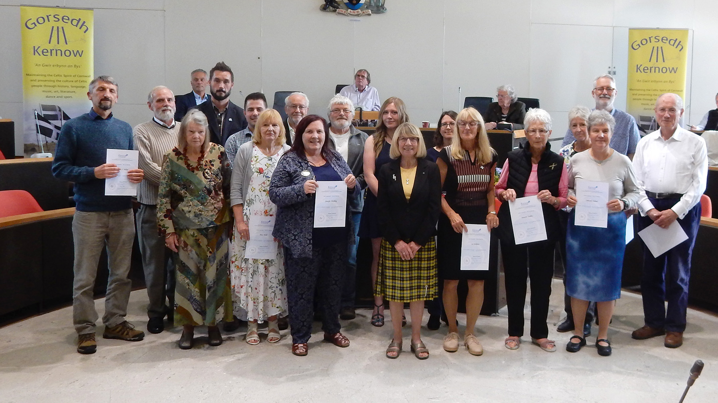
Solempnita

Slide 7
Nessa gradh
 |  | 2019 |  | 2018 |  | 2017 |  | 2016
ombrofyer |  | 24 |  | 23 |  | 19 |  | 16
 | max | mean | % | mean | % | mean | %
Gov kemm | 50 | 44.3 | 88.6 | 43.3 | 86.6 | 41.8 | 83.6 | 42.6 | 85.2
Gwari rol | 30 | 25.8 | 86 | 24.5 | 81.7 | 23.4¹ | 78 | 22.4² | 74.7 | ¹12.8/15; 10.7/15 ²11.7/15; 10.8/15
goslowes | 20 | 12.1 | 60.5 | 13.3 | 66.5 | 13.8 | 69 | 15.4 | 77.0
myns war anow | 100 | 82.2 |  | 81.1 |  | 79 |  | 80.5
Govyn 1 | 20 | 13.1 | 65 | 15.4 | 77 | 11 | 55 | 13.6 | 68.0
Govyn 2 | 25 | 19.0 | 76 | 19.1 | 76.4 | 20.5 | 82 | 19.3 | 77.2
Govyn 3 | 30 | 25.6 | 85 | 24.7 | 82.3 | 22.3 | 74.3 | 22.8 | 76.0
Govyn 4 | 25 | 15.8 | 63.2 | 17.6 | 70.4 | 18.3 | 73.2 | 18 | 72.0
myns skrifys | 100 | 73.7 |  | 76.7 |  | 72 |  | 73.6
myns w.a ha skrifys | 100 | 78.8 |  | 78.9 |  | 76.8 |  | 77

